Slide 1
Federal Election 2022: What happened and why?
A sullen electorate grudgingly gave its verdict

Slide 2
Bare Bones

Slide 3
Movement in the minor parties

Slide 4
Two-Party Preferred
Party / Coalition | Votes | Percentage % | Swing %
Liberal/National Coalition | 6,580,728 | 48.02 | -3.51
Australian Labor Party | 7,124,802 | 51.98 | 3.51

Slide 5
2022 Labor Bare Majority

Slide 6
2019 Coalition Bare Majority

Slide 7
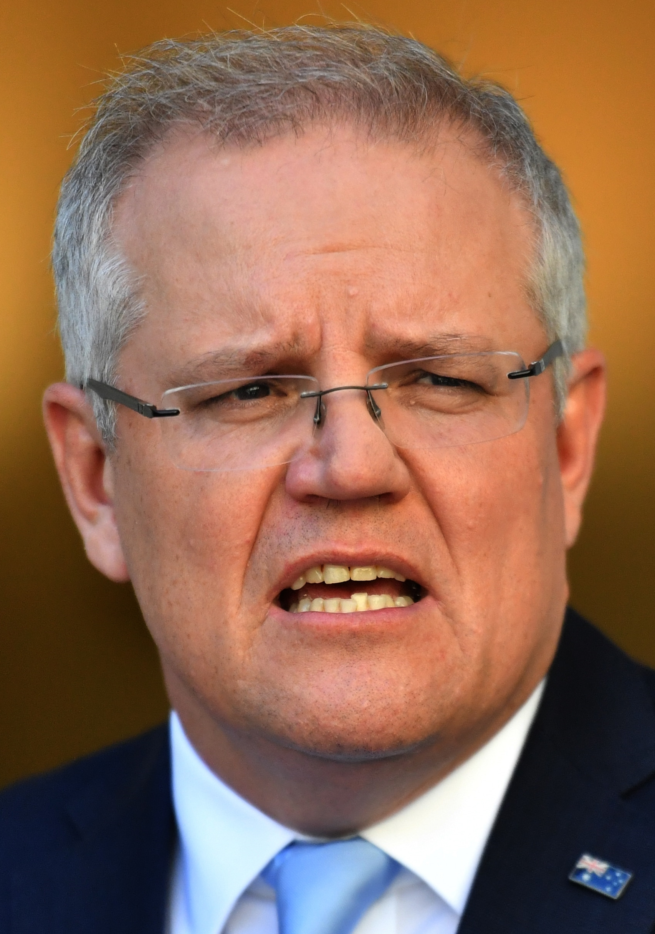
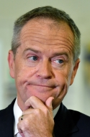
The Beginning – 2019 Federal Election
This man didn’t win the election, but he became Prime Minister
This man lost the election

Slide 8
Factors in Labor’s 2019 Loss
Big target strategy
Alienated
Pensioners
Savers
Inheritors
Bill Shorten’s woman problem
Expectations
Bob Brown

Slide 9
Result
Morrison small majority – timid
Alienated his base
Albanese small target strategy – timid
Alienated his base
Seinfeld Election

Slide 10
Other Factors
Long time in power. Menzies/Holt etc. 25 years, 11 months, 2 weeks. Bob Hawke/Paul Keating 13 years, John Howard 11 years, UAP Lyons/Menzies 10, Abbott/Turnbull/Morrison 9 years, Fraser 7 years Rudd/Gillard/Rudd 6 years
Shambolic Liberal Party
NSW
WA
Teals
Flanking attack
Scott Morrison

Slide 11
Was this a climate change election?

Slide 12
Yes and No

Slide 13
Direction

Slide 14
Approval PM

Slide 15
Approval ALbanese

Slide 16
Preferred PM

Slide 17
Government deserves to be elected

Slide 18
Opposition deserves to be elected

Slide 19
Expect to win

Slide 20
Deserves to win

Slide 21
Coalition ran protest campaign
What is a protest vote campaign? “Won’t be easy under Albanese”
Why? The “vision thing” probably
No rhetorical path to address major swing issues
Needed to keep the focus off the leader
Tried to reboot their campaign using national security
Too late
Not focussed
Sabotaged by the Chinese
Possibly alienated the Chinese vote

Slide 22
Coalition Alienated its Base and failed to argue its case
Sky high government spending
Net Zero 2050
Free Speech
Religious Discrimination
Education
Women’s issues

Slide 23
Labor small target and personal attacks
43% drop in emissions by 2030
Anti-corruption body
Electricity guarantee - $275 pa
Aged care – more staff higher wages
Health – cheaper medicines, access to a doctor, new medical clinics
Housing – shared equity scheme
IT – Networking the nation

Slide 24
Female vote
Personalities stronger than policies this election
Morrison aggressive
Albanese a victim but a trier
A world run by Oedipal Mothers that valorises the victim
People got to know Albanese better and they liked what they saw. Albanese’s approval improved while Morrison’s declined

Slide 25
Protest vote worked, but LNP hoist on its own petard, ALP barely met minimum expectations
Voters protested against both major parties
Minor parties increased
Protest a significant factor for Greens, Freedom and Teals. Their vote overstated.

Slide 26
Let’s talk duck
Teals fastest growing political movement in Australia
Geographically confined
Middle-aged, female, professional
Talk climate, accountability and economics
Represent narrow corporate interest – run as a franchise business

Slide 27
Teal Strategy
Psycho-demographic profiling of seats
Select targets
Select products
Market as something new and fresh
Exploits splits within the Liberal and Labor parties
Flaw – possible there is Teal anti-matter

Slide 28
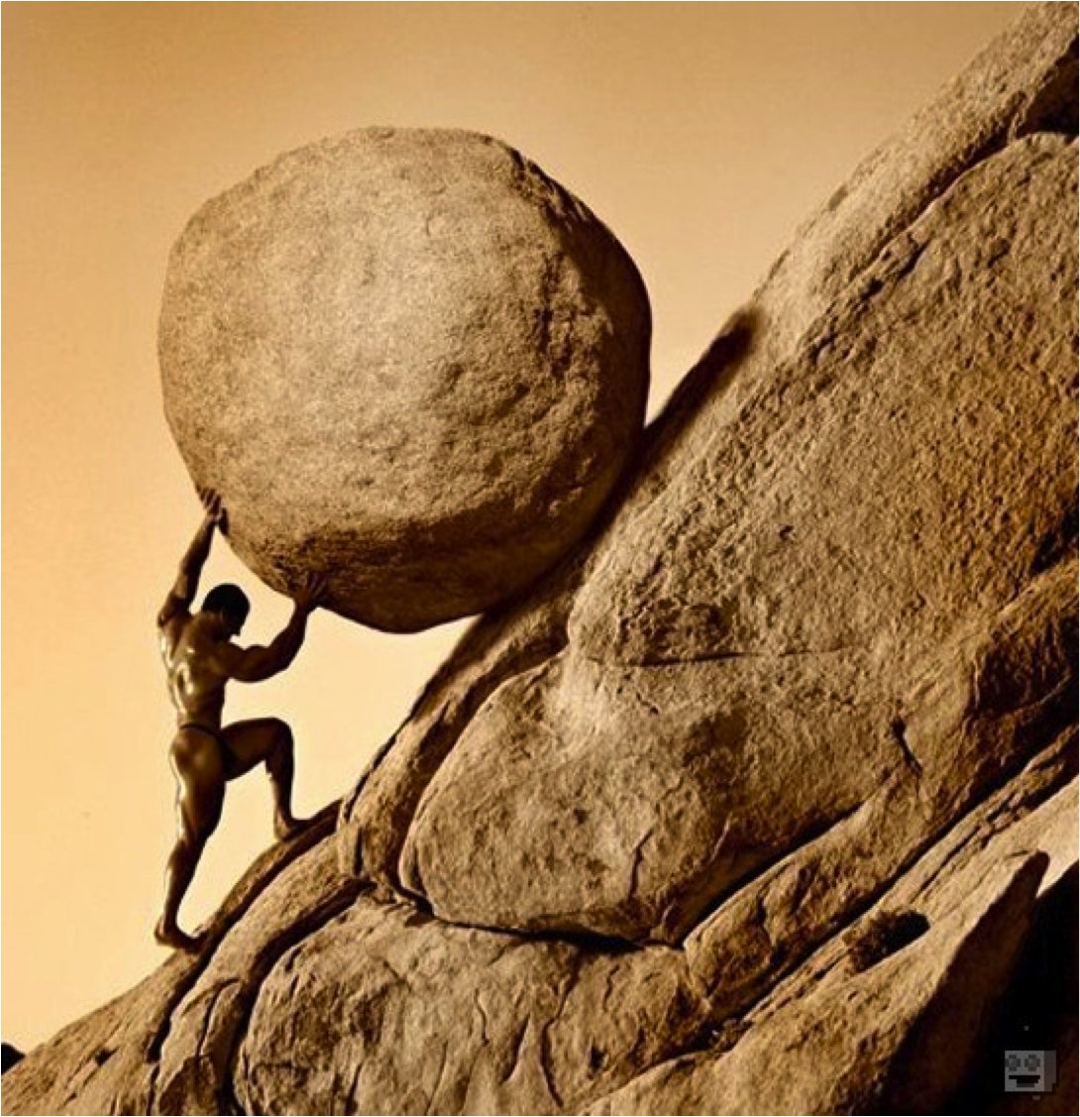
Until next election
Graham Young Executive Director Australian Institute for Progress 0411 104 801 graham.young@aip.asn.au

